Slide 1

Artificial Intelligence
Epoka University
EMPLOYEE ATTRITION PREDICTION SYSTEM
People are the foundation of
every successful organization

Slide 2

PROBLEM FORMULATION
(PEAS)
Performance Measure
Environment
ROC-AUC (ranking quality)
Recall (prioritized due to attrition cost)
F1-score (precision–recall balance)
Accuracy not used due to class imbalance
Static, partially observable HR environment
Historical employee data
Stochastic (human behavior is unpredictable)
and administrative tasks
Task: Predict whether an employee is at risk of attrition
Actuators
Sensors
Binary decision: Attrition Risk / No Attrition
In hybrid system, decision can come from rules or ML
Employee attributes (age, income, overtime, tenure, satisfaction, etc.)

Slide 3



MEANINGFUL
HR
DATA
DATASET CHOICE
Next Slide
The dataset reflects real-world employee data
The chosen dataset is the HR Employee Attrition dataset, which contains employee demographic, job-related, and satisfaction attributes.
The target variable is Attrition, indicating whether an employee leaves the company.
This is an imbalanced classification problem, as the majority of employees stay while a smaller portion leave.
Predicting attrition is important because losing employees is costly for organizations in terms of recruitment, training, and productivity.

Slide 4
RULE-BASED
RANDOM FOREST
HYBRID SEQUENTIAL
AI METHODOLOGY
1
2
3
Rule-based
Random Forest
Hybrid Sequential
Chosen for interpretability and transparency
Suitable when expert knowledge exists
Allows abstention when confidence is low
Chosen over simpler models (e.g. Decision Trees) because:
Handles non-linear relationships
Robust to noise
Works well on tabular HR data
Outputs probabilities → enables threshold tuning
Combines interpretability and predictive power.
Improves recall compared to Random Forest alone.
Ensures full coverage while maintaining explainability.

Slide 5
IMPLEMENTATION
Intelligent Agent Design:
PREDICTIVE
MODELS
BUILT
Next Slide
Agent Type
Hybrid sequential intelligent agent
Combines symbolic reasoning and learning
Decision Flow
Rule-based agent evaluates employee
If a rule fires → decision is produced
If rules abstain → Random Forest predicts
Final decision returned to user
Key Design Choice
Rule-based decisions are preserved
Random Forest ensures full coverage

Slide 6
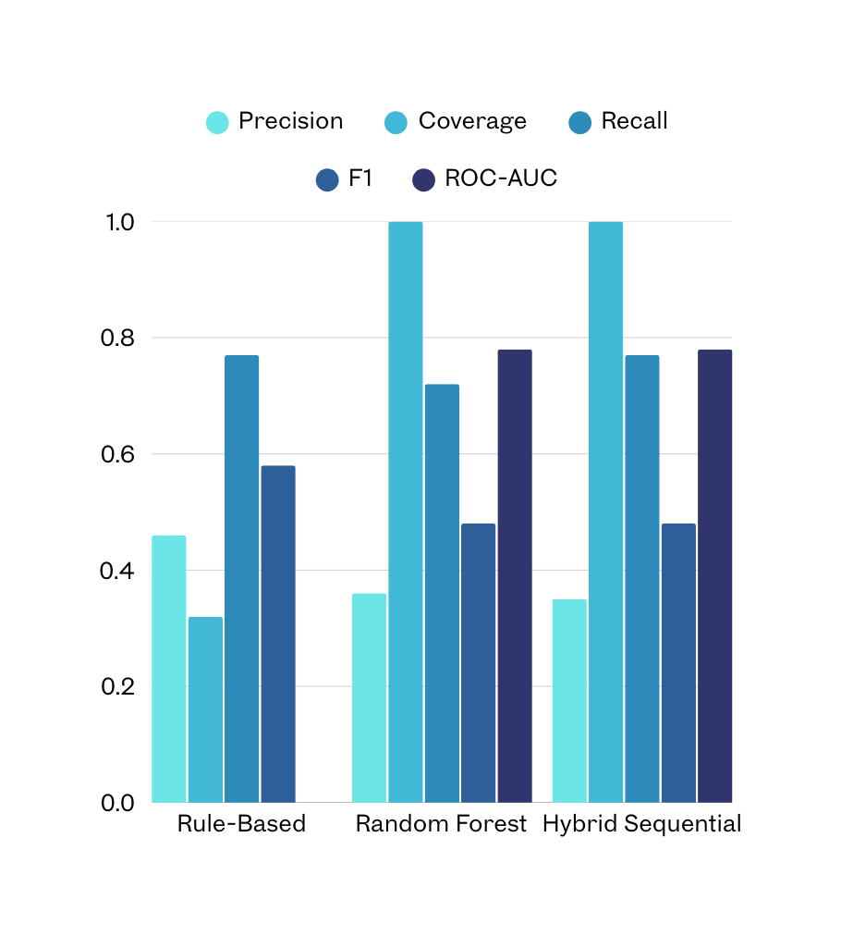
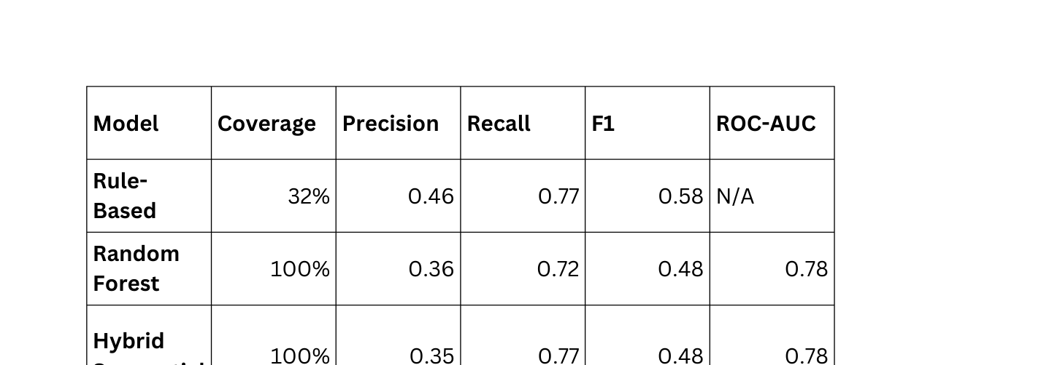
RESULTS & ANALYSIS
METRICS
PERFORMANCE
RESULTS

Slide 7


FUTURE
WORK
IMPROVEMENTS
FUTURE WORK & IMPROVEMENTS
Next Slide
Incorporate temporal data (employee history over time)
Test additional models (XGBoost, Logistic Regression)
Improve rule learning using data-driven rule extraction
Introduce fairness analysis and bias mitigation by analyzing whether the system produces biased predictions for specific employee groups.
Deploy system as a real HR decision-support tool
FUTURE
WORK
IMPROVEMENTS

Slide 8
Epoka University
AI improves attrition prediction.
Worked by:
Suada Terolli, Alesia Dardha
AI-DEMO
Now let’s see the Demo!
THANK YOU!
ARTIFICIAL INTELLIGENCE
-
SWE 3C

